Slide 1
Clustering
4 Types of Clustering Algorithm

Slide 2
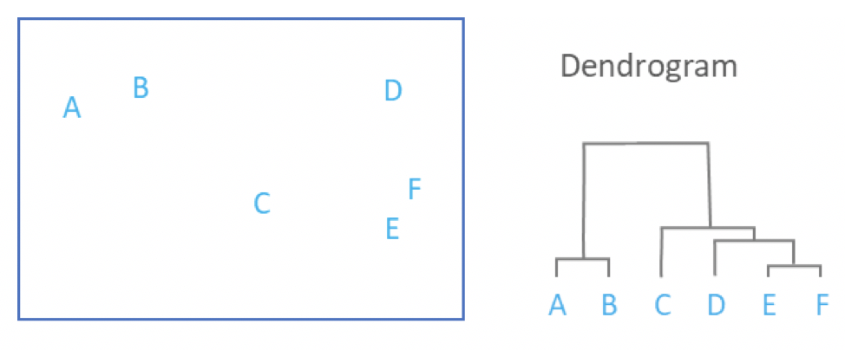
Hierarchical Clustering Algorithm
Hierarchical clustering, also known as hierarchical cluster analysis, is an algorithm that groups similar objects into groups called clusters. The endpoint is a set of clusters, where each cluster is distinct from each other cluster, and the objects within each cluster are broadly similar to each other.
1. Widely used in DNA sequencing to analyze the evolutionary history and the relationships among biological entities (Phylogenetics).
2. Identifying fake news by clustering the news article corpus, by assigning the tokens or words into these clusters and marking out suspicious and sensationalized words to get possible faux words.
3. Personalization and targeting in marketing and sales.
4. Classifying the incoming network traffic into a website by classifying the http requests into various clusters and then heuristically identifying the problematic clusters and eventually restricting them.

Slide 3
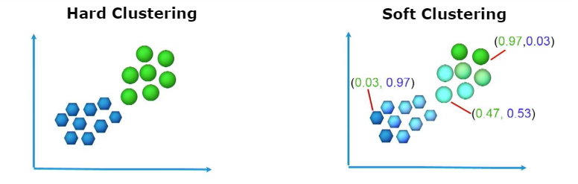
Fuzzy C Means Algorithm – FANNY (Fuzzy Analysis Clustering)
Automated fuzzy clustering is a method of clustering that provides one element of data or image belonging to two or more clusters. The method works by allocating membership values to each image point correlated to each cluster center based on the distance between the cluster center and the image point.
1. Used widely in Image Segmentation of medical imagery, especially the images generated by an MRI.
2. Market definition and segmentation.

Slide 4
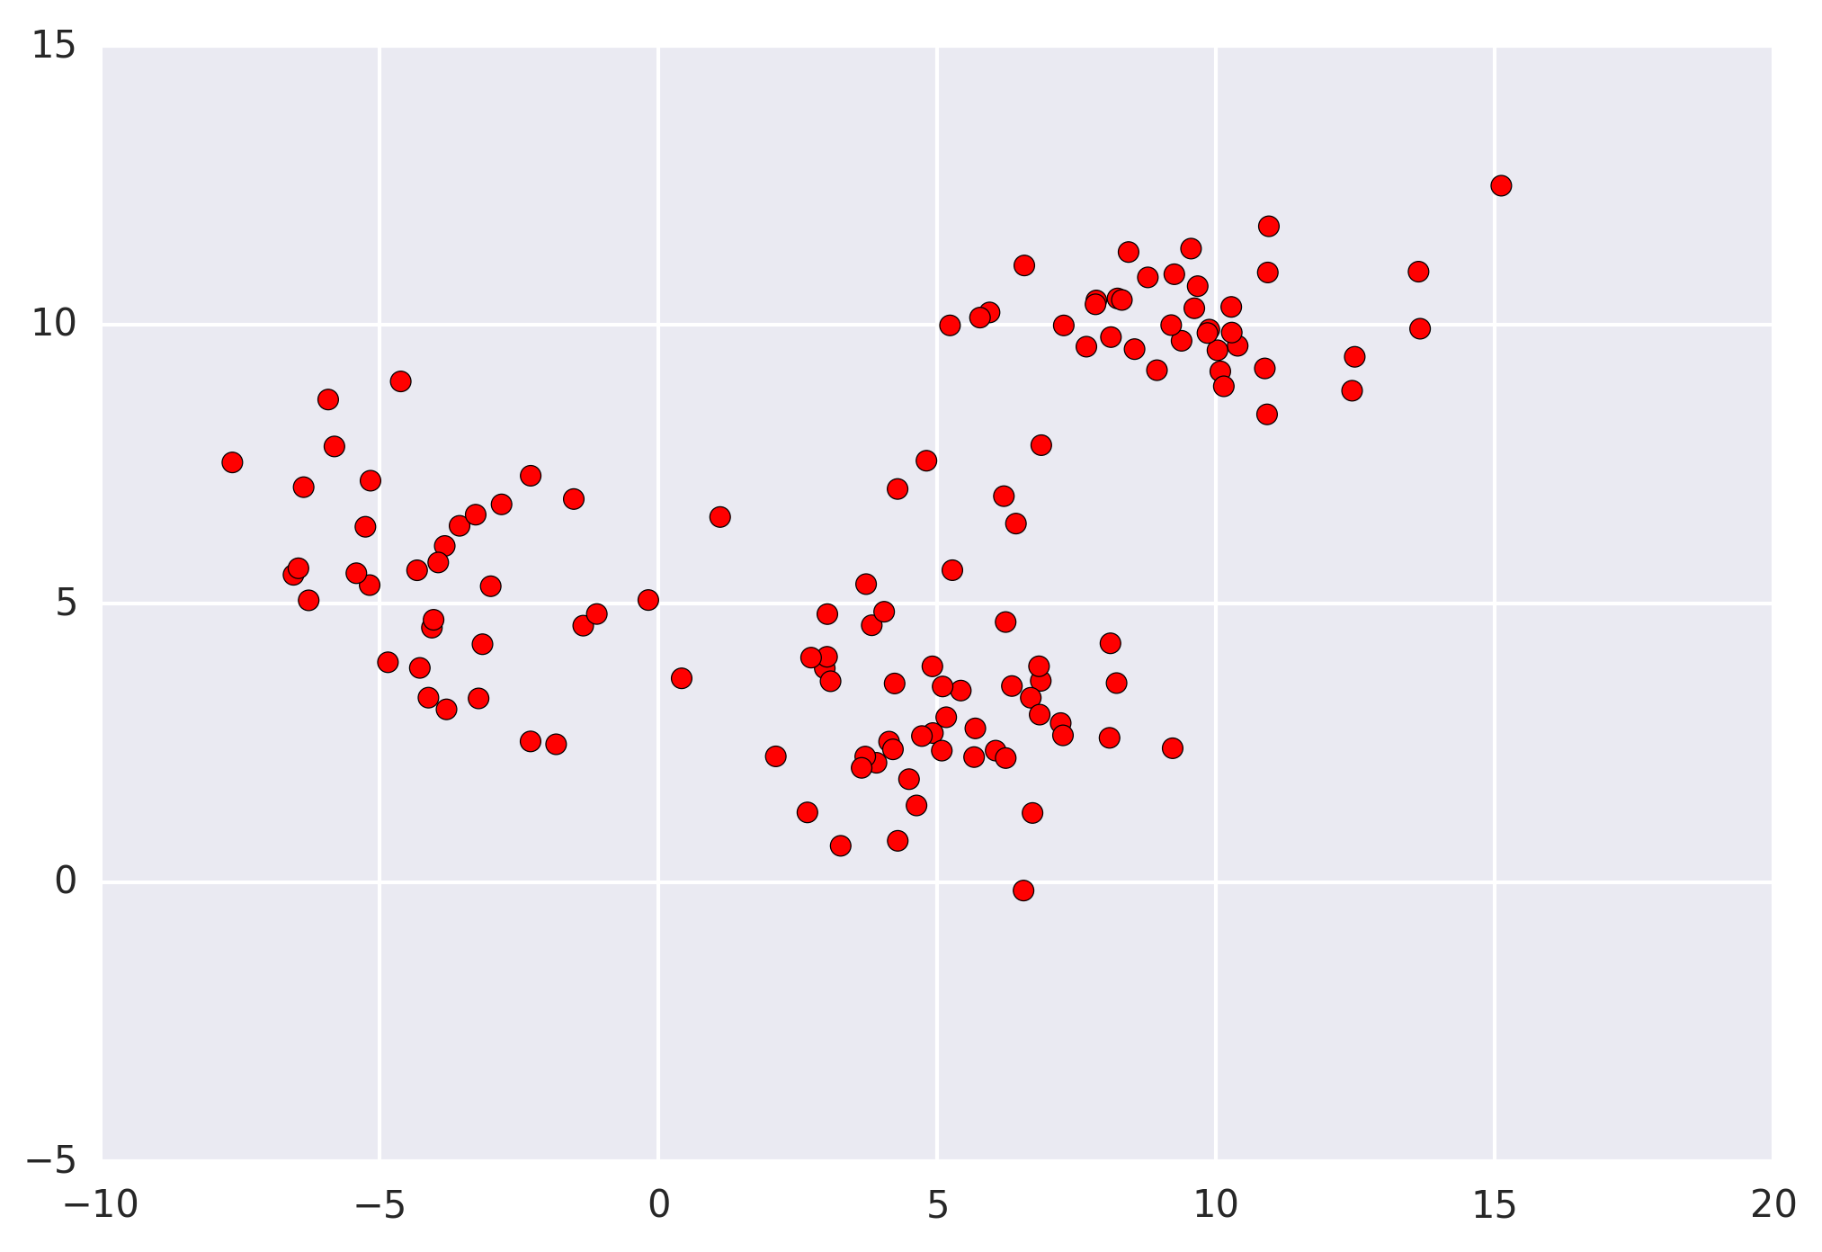
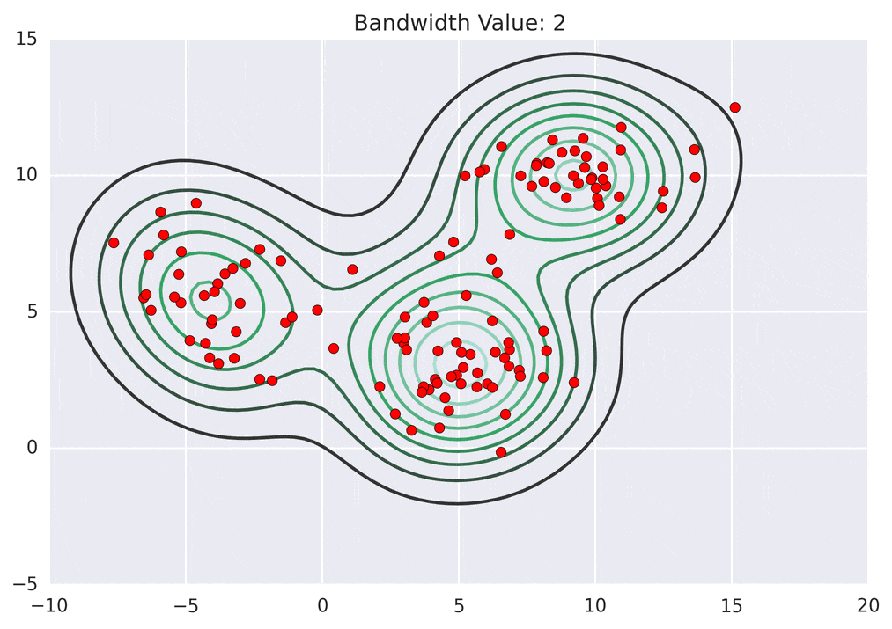
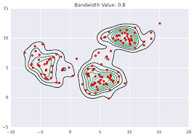
Mean Shift Clustering
Mean shift clustering algorithm is a centroid-based algorithm that helps in various use cases of unsupervised learning. ... It works by shifting data points towards centroids to be the mean of other points in the region. It is also known as the mode seeking algorithm.
1. Image segmentation and computer vision – mostly used for handwritten text identification.
2. Image tracking in video analysis.

Slide 5
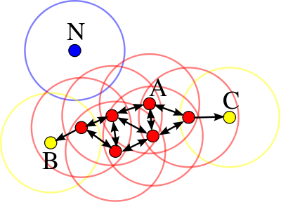
DBSCAN – Density-based Spatial Clustering
Density-based spatial clustering of applications with noise (DBSCAN) is a data clustering algorithm proposed by Martin Ester, Hans-Peter Kriegel, Jörg Sander and Xiaowei Xu in 1996. ... DBSCAN is one of the most common clustering algorithms and also most cited in scientific literature.
1. Used in document Network Analysis of text data for identifying plagiarism and copyrights in various scientific documents and scholarly articles.
2. Widely used in recommendation systems for various web applications and eCommerce websites.
3. Used in x-ray Crystallography to categorize the protein structure of a certain protein and to determine its interactions with other proteins in the strands.
4. Clustering in Social Network Analysis is implemented by DBSCAN where objects (points) are clustered based on the object’s linkage rather than similarity.

